Slide 1
SOCIAL MEDIA CONTENT PLAN
August 2021

Slide 2
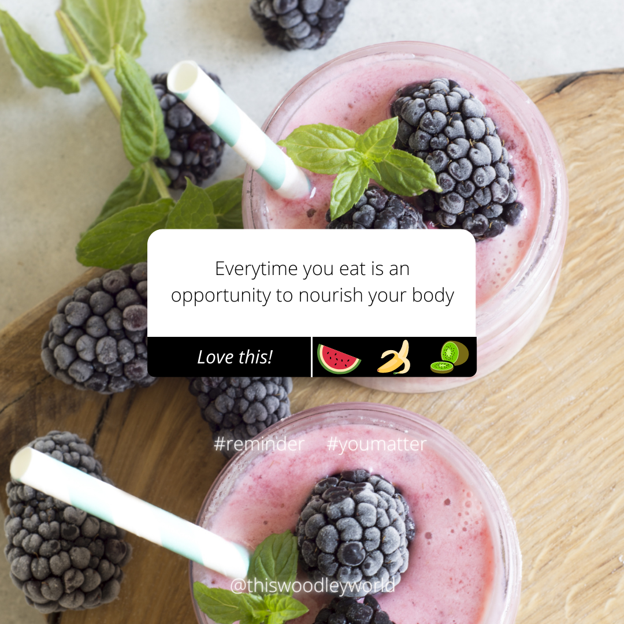
Facebook (Organic)
[Sunday, 1st August 2021]

Slide 3

Facebook (Organic)
[Tuesday, 3rd August 2021]
Hump day feels: remedial massage

Slide 4
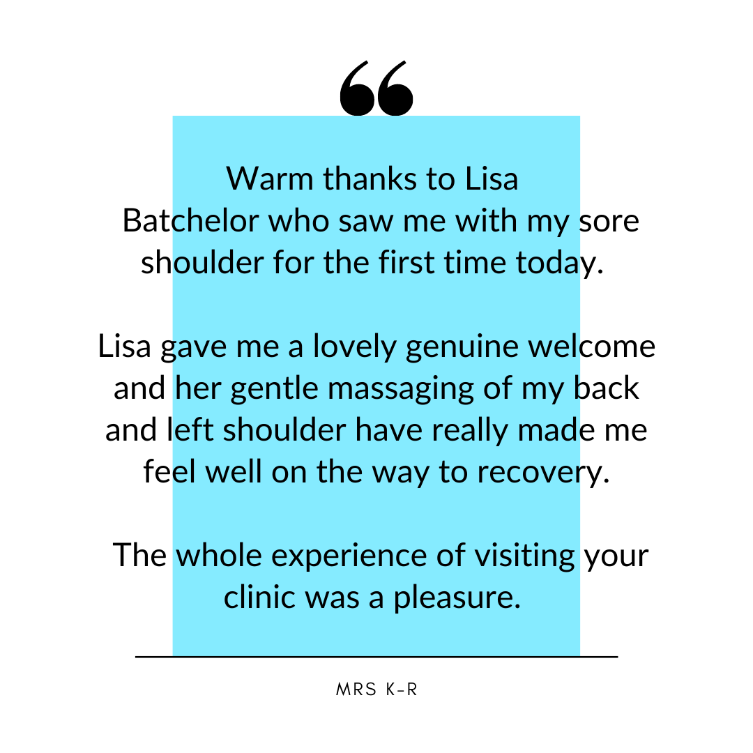
Facebook (Organic)
[Thursday, 5th August 2021]

Slide 5
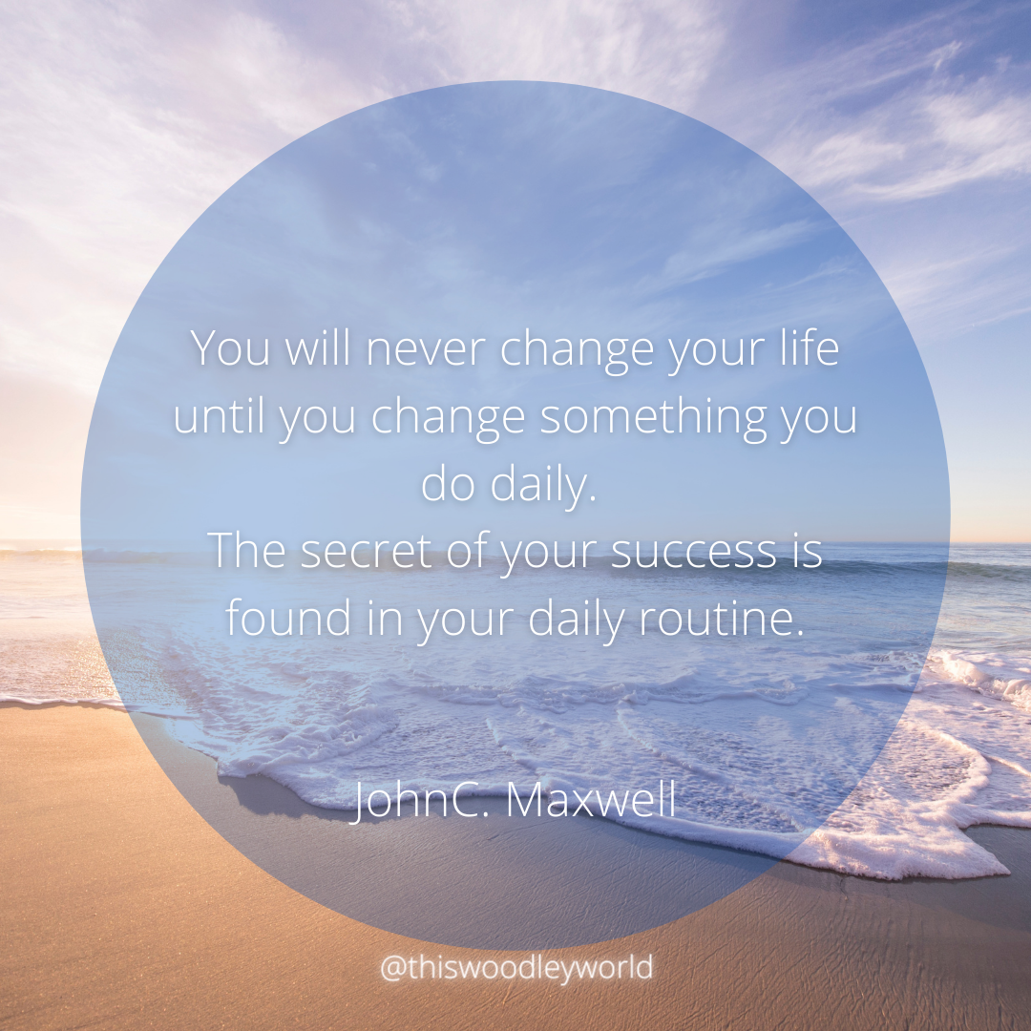
Facebook (Organic)
[Sunday, 8th August 2021]

Slide 6
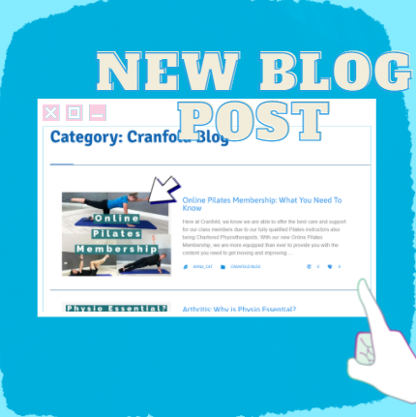
Facebook (Organic)
[Monday, 9th August 2021]

Slide 7
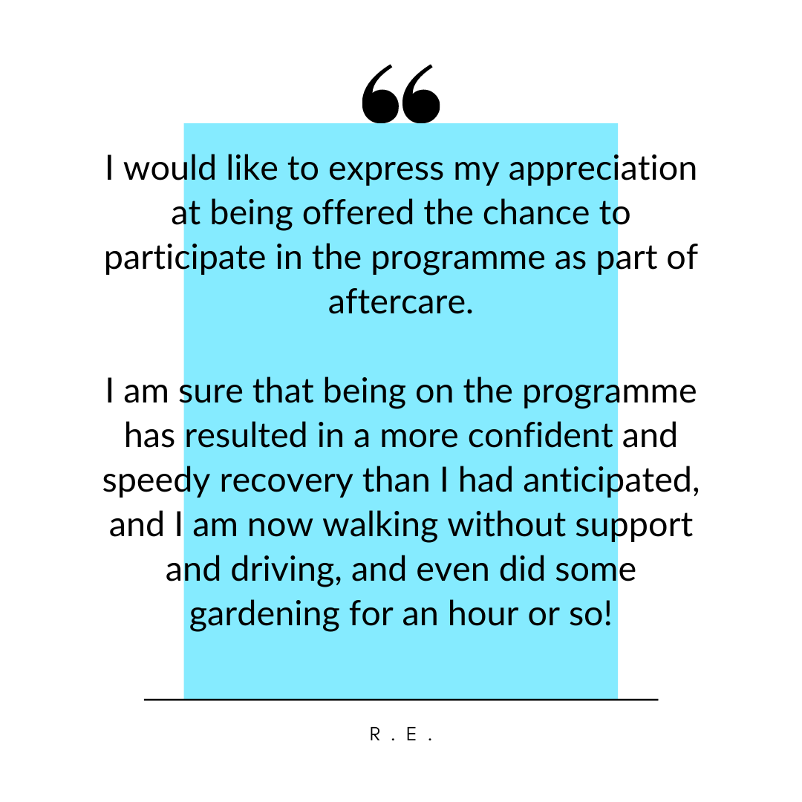
Facebook (Organic)
[Thursday, 12th August 2021]

Slide 8
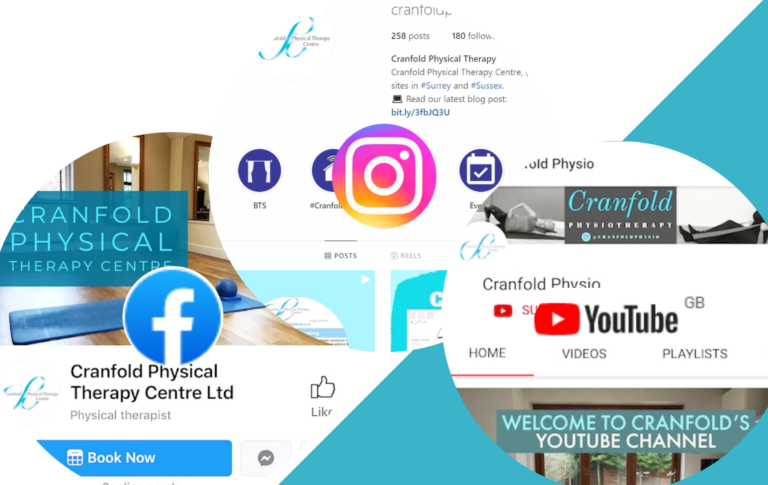
Facebook (Organic)
[Friday, 13th August 2021]
Stay connected:
Social platform boost

Slide 9
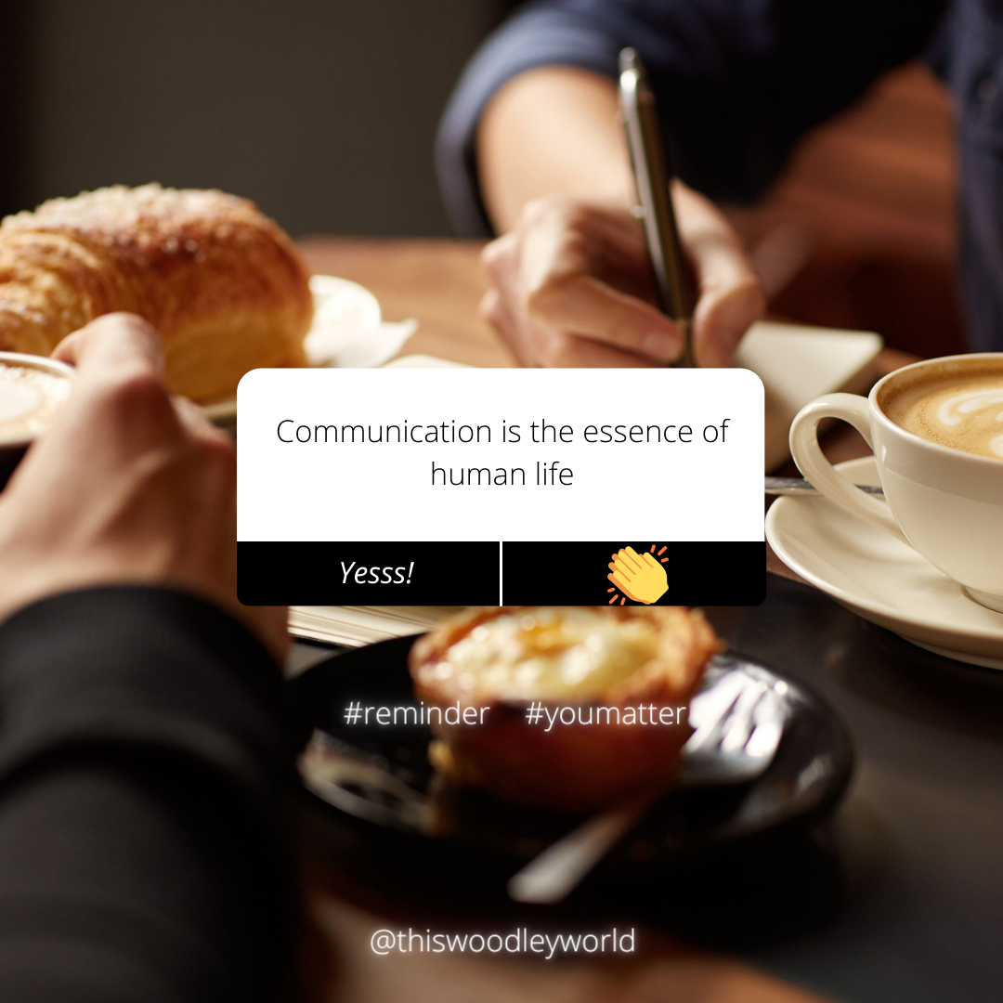
Facebook (Organic)
[Sunday, 15th August 2021]

Slide 10
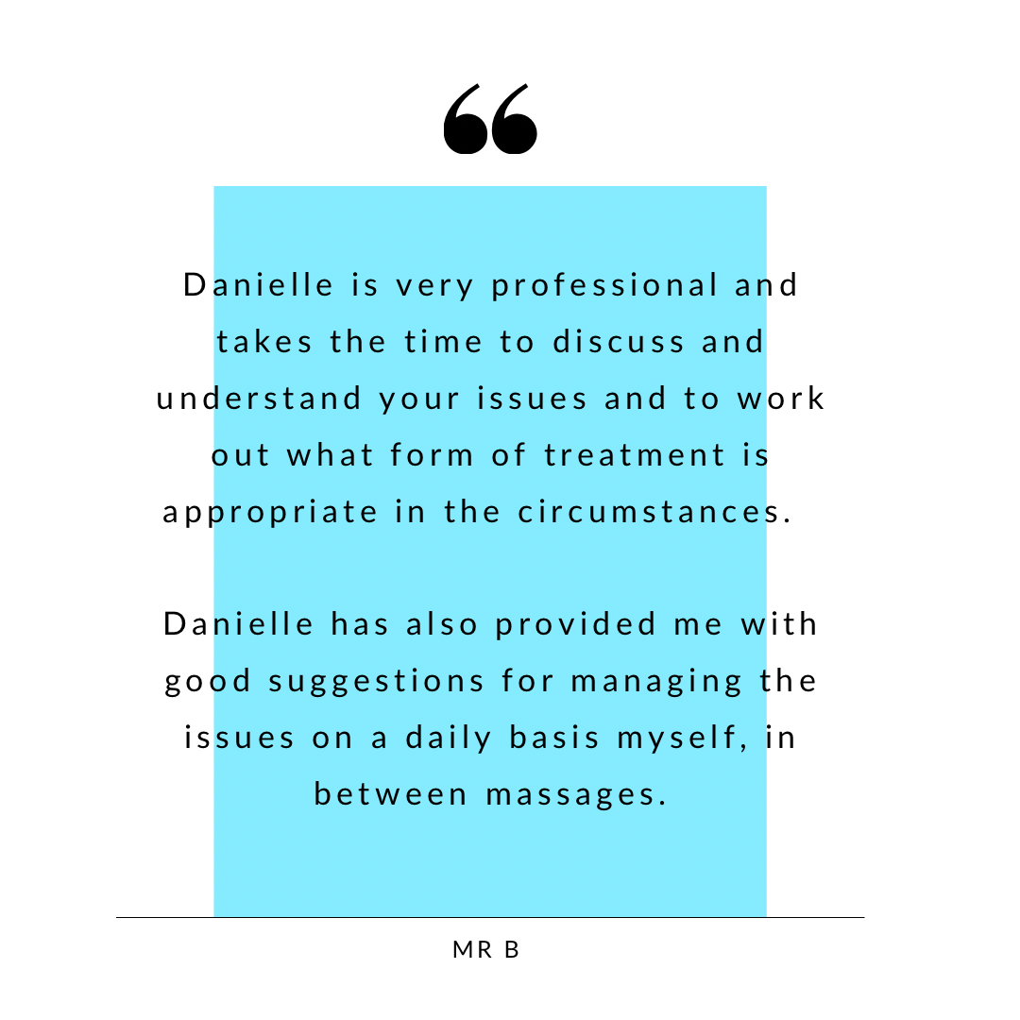
Facebook (Organic)
[Tuesday, 17th August 2021]

Slide 11
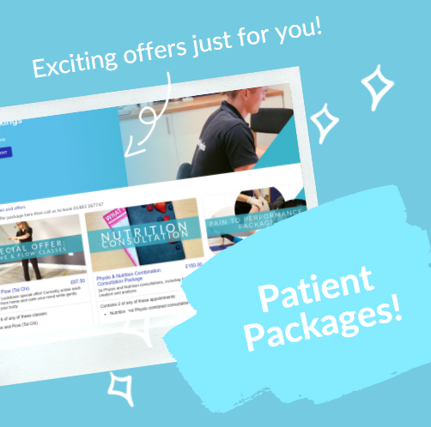
Facebook (Organic)
[Saturday, 21st August 2021]
Packages promotion

Slide 12

Facebook (Organic)
[Sunday, 22nd August 2021]

Slide 13
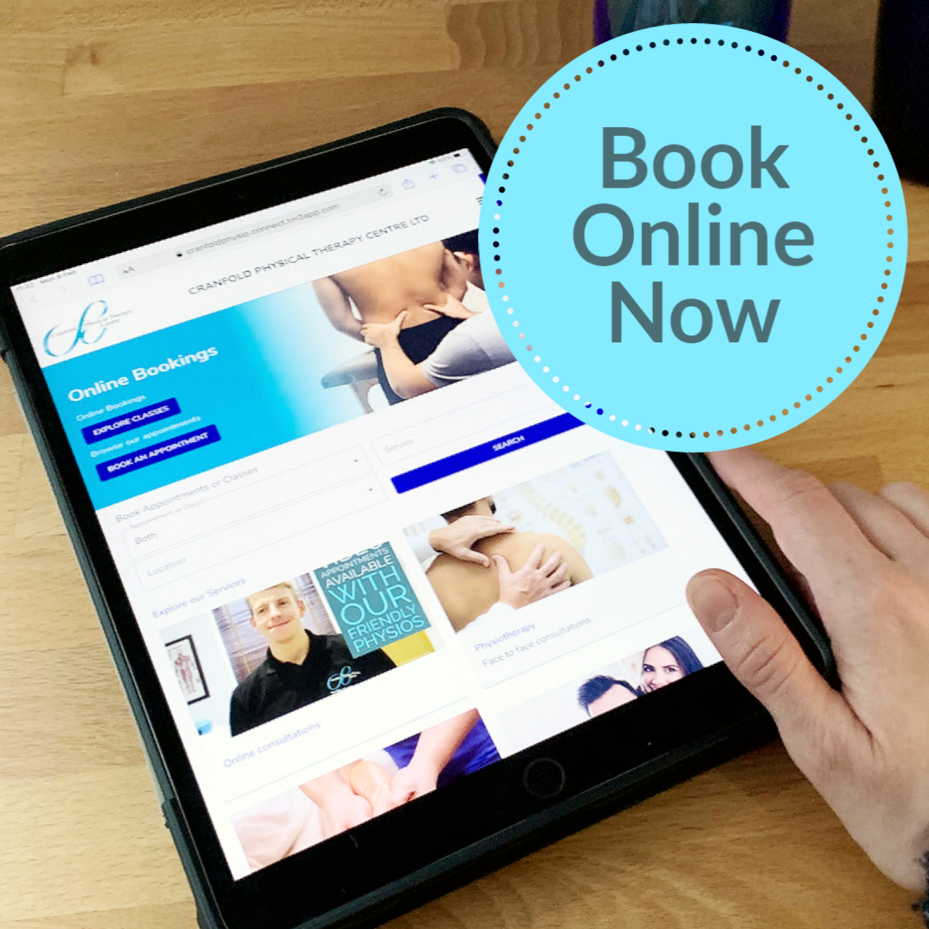
Facebook (Organic)
[Tuesday, 24th August 2021]

Slide 14
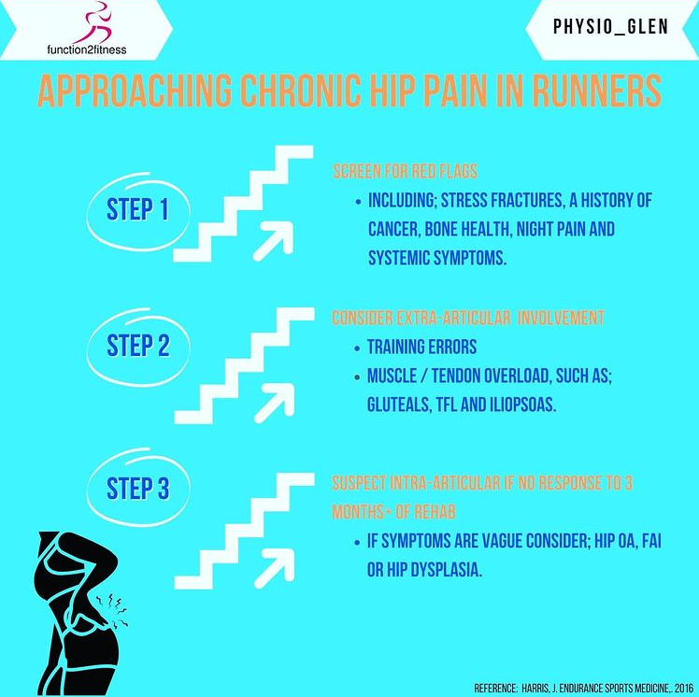
Facebook (Organic)
[Wednesday 25th, August 2021]
We love this collaborative infographic with @phyiso_glen and @function2fitness: A three step approach to hip pain in runners.
Check out the IGTV for further discussion on the topic.

Slide 15
Facebook (Organic)
[Friday, 27th August 2021]
OPM –
access anywhere and
around your new busy social life!
Share trailer from wetransfer

Slide 16
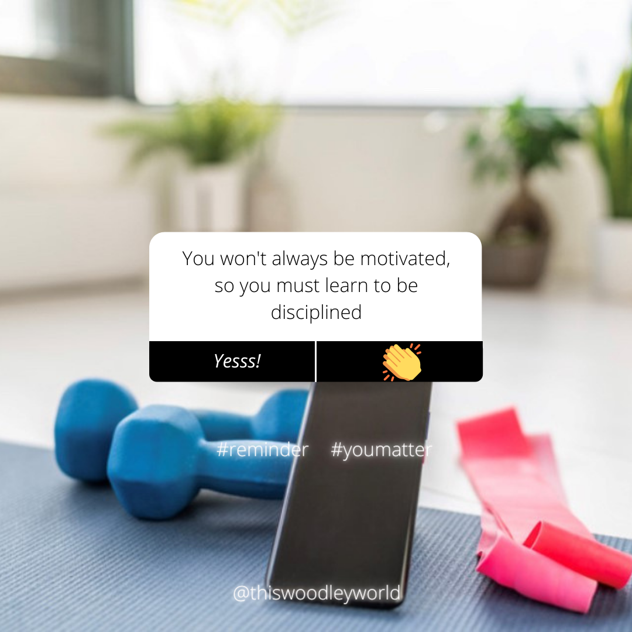
Facebook (Organic)
[Sunday, 29th August 2021]

Slide 17
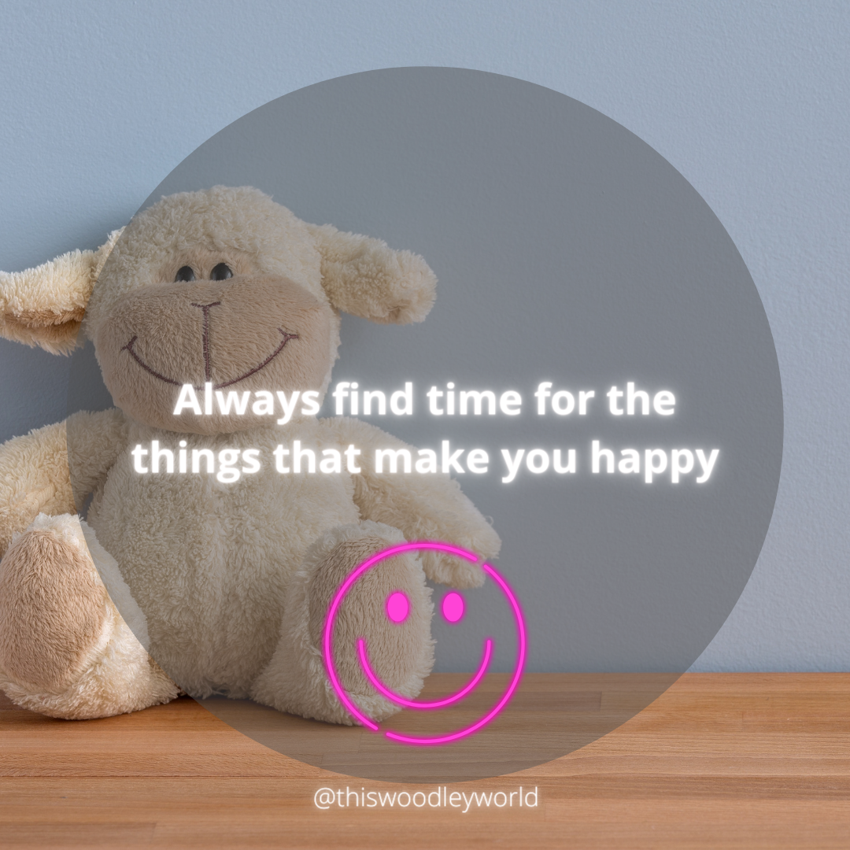
Facebook (Organic)
[Monday, 30th August 2021]

